Slide 1

JavaScript
Lecture 3. Functions & Array

Slide 2

Lesson Plan
Function Declaration
Function Expression
Parameters
Return
Self Execution Functions
Scope
Clousers
Array overview
Arguments
Arrow Functions
Functions Strict Mode

Slide 3
Functions
One of the fundamental building blocks
A set of statements that performs a task or calculates a value

Slide 4
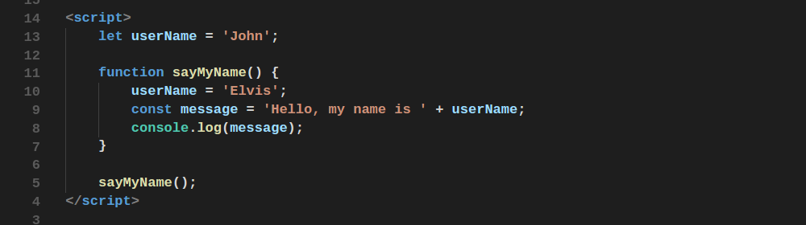
Functions Declaration

Slide 5
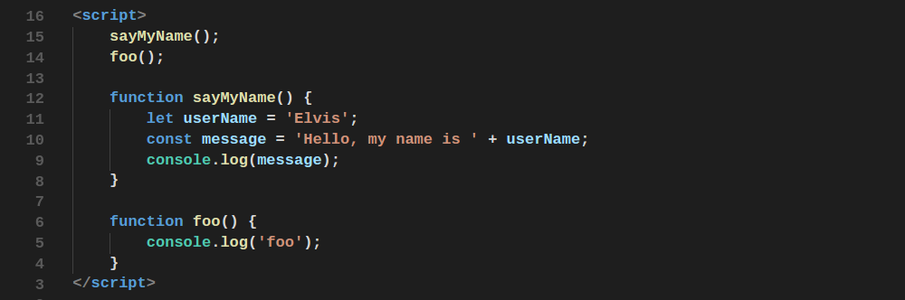
Functions Declaration
All declared functions are available from everywhere in scope where them were declared.

Slide 6
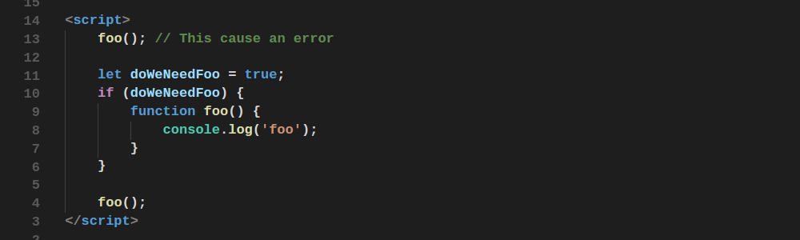
Functions Declaration
Declarations in blocks

Slide 7
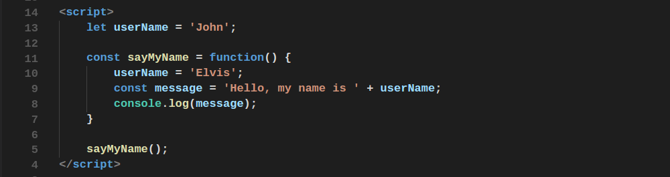
Functions Expression

Slide 8
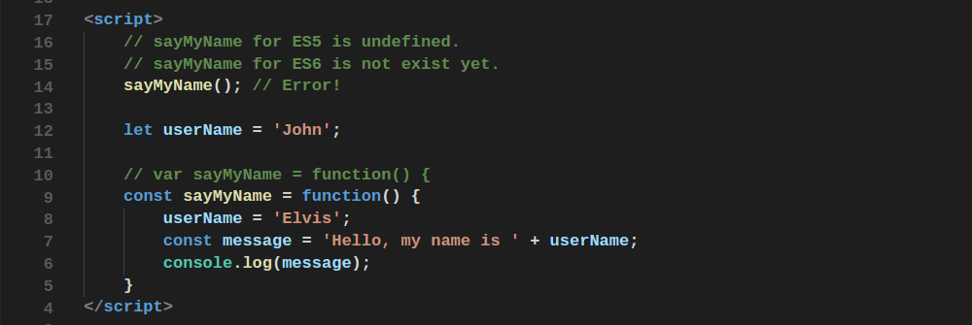
Functions Expression
Function expressions does not hoist.

Slide 9
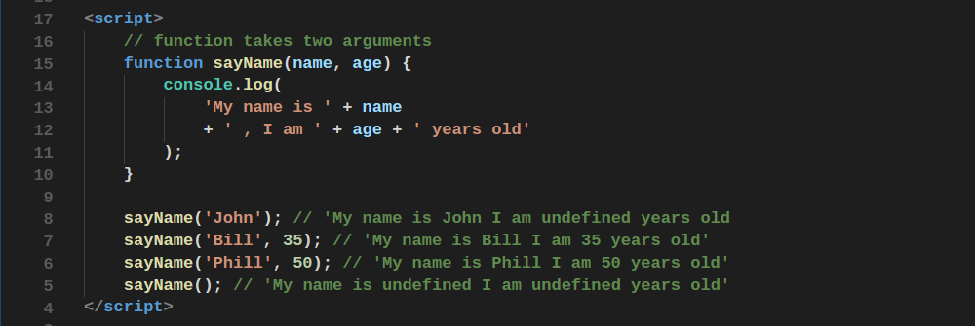
Functions Arguments

Slide 10
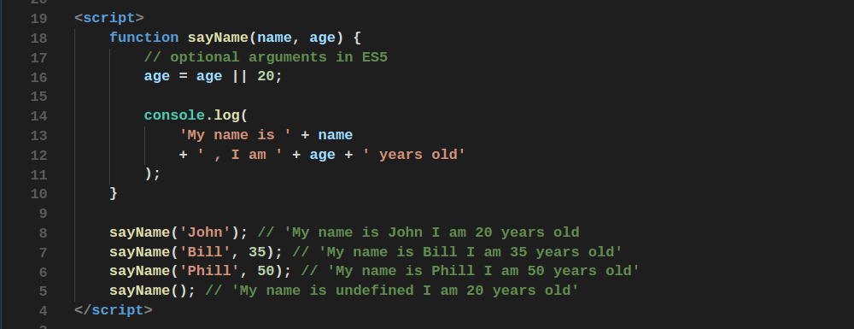
Functions Optional Arguments
ES5 style

Slide 11
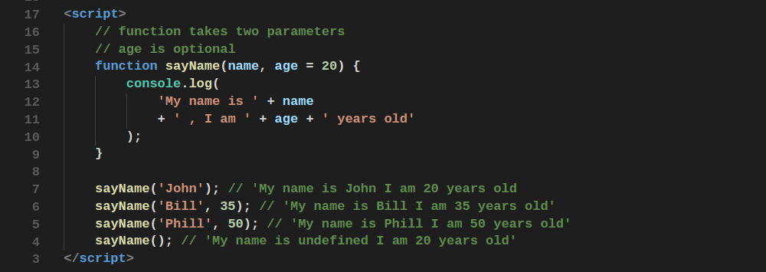
Functions Optional Arguments
ES6 style. Option arguments should be declared in end of the arguments list

Slide 12
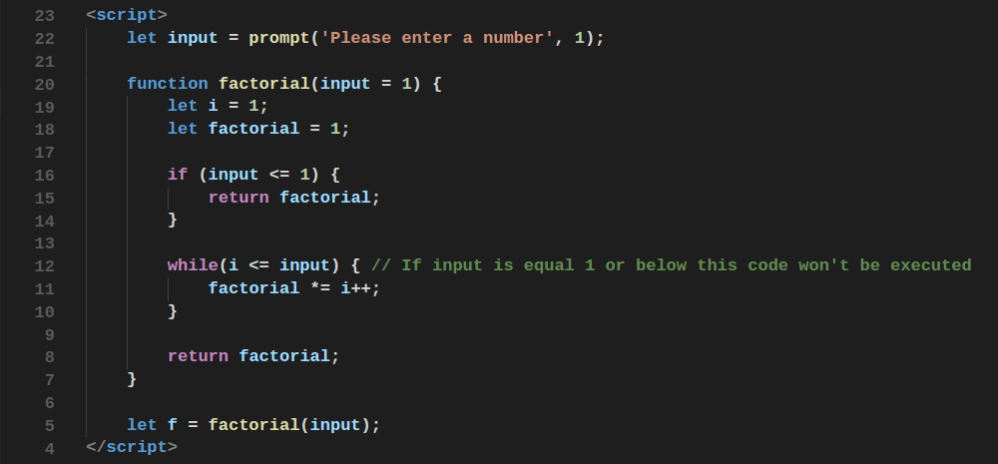
Return

Slide 13
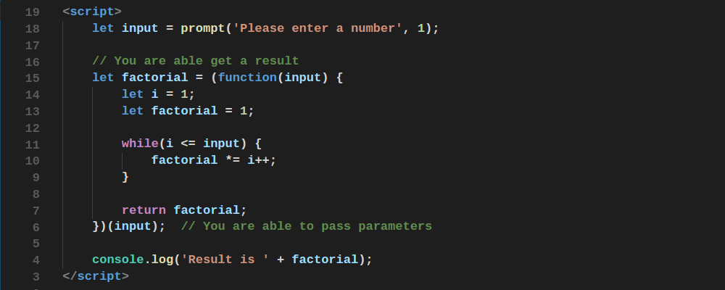
Self Execution Functions

Slide 14
Scope
Scope determines accessibility of functions and variables
In JavaScript there are two types of scopes:
Global Scope
Local Scope

Slide 15
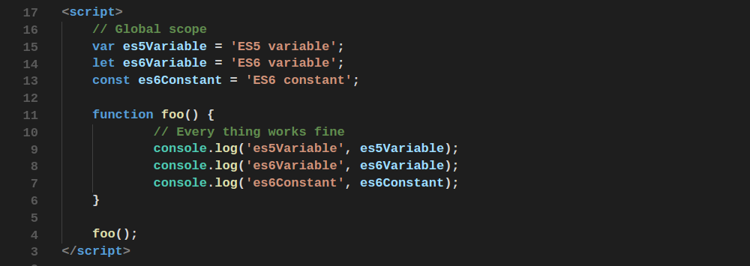
Global Scope
Scope determines accessibility of functions and variables

Slide 16
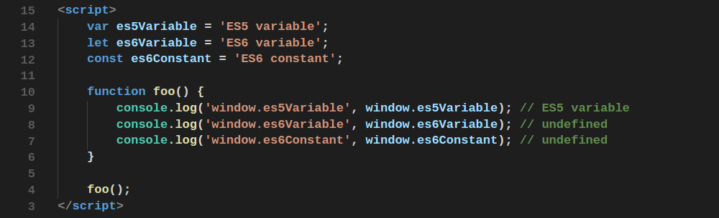
Scope
All ES5 global variables are members of the window object, but not ES6

Slide 17
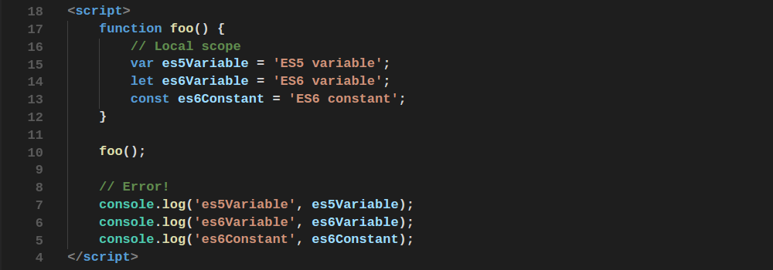
Local Scope
There is no way to access local variable

Slide 18
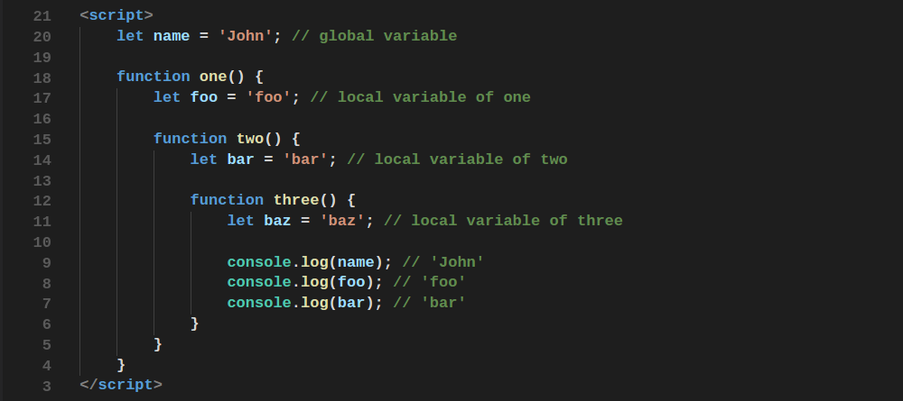
Scope Chaining
I

Slide 19
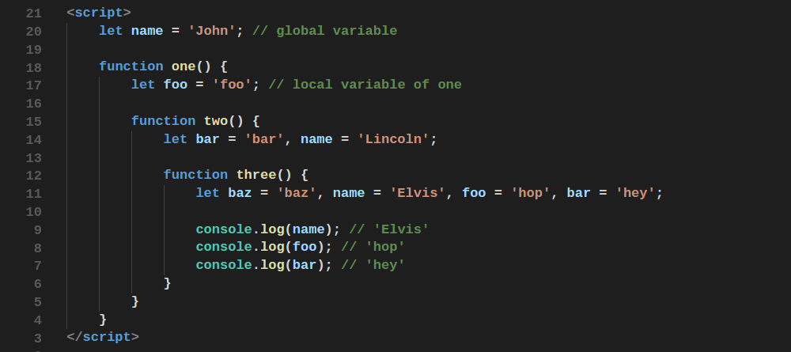
Scope Chaining
I

Slide 20
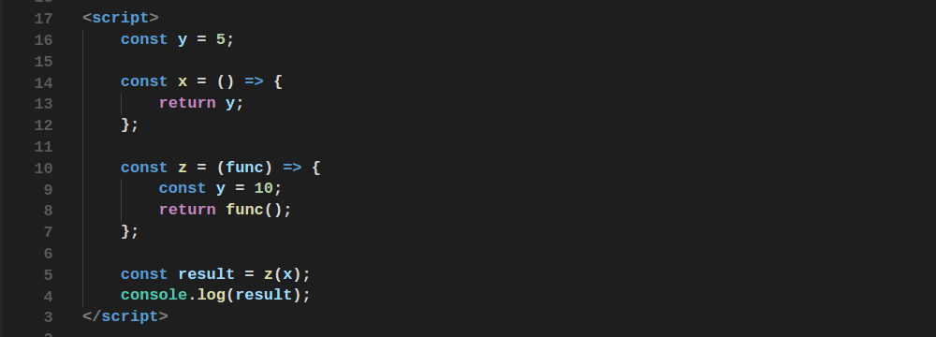
Lexical Environment
Functions in JavaScript have a lexical scope
I

Slide 21
Closures
Closures give us ability to encapsulate some data or functional
Let’s write a counter to demonstrate it

Slide 22
Closures
Closures give us ability to encapsulate some data or functional
Let’s write a singleton counter to demonstrate it

Slide 23
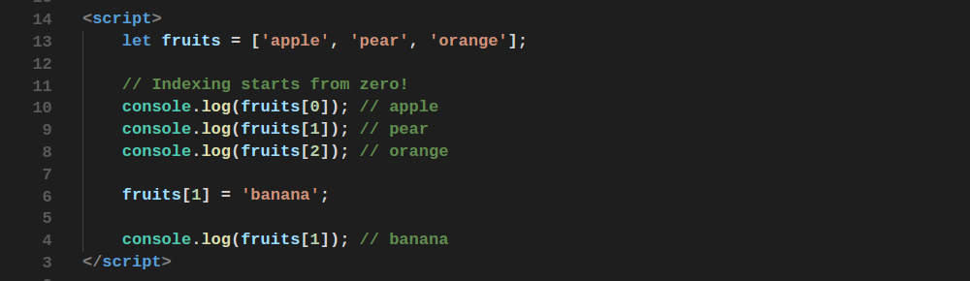
Array
Brief overview

Slide 24
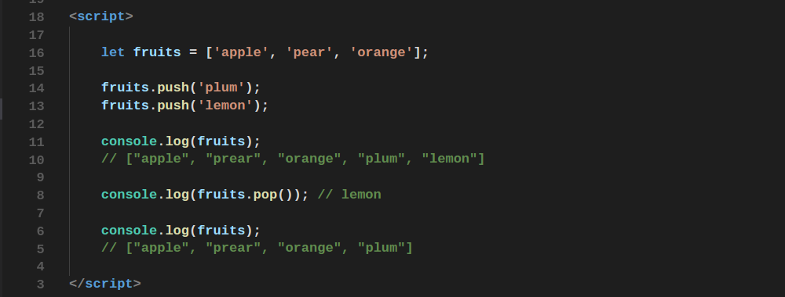
Operations with array
push - adds new element to the end of the given array

Slide 25
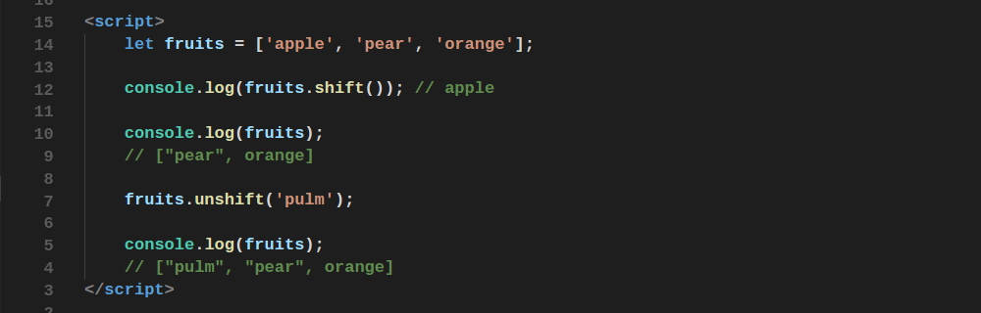
Operations with array
shift and unshift

Slide 26
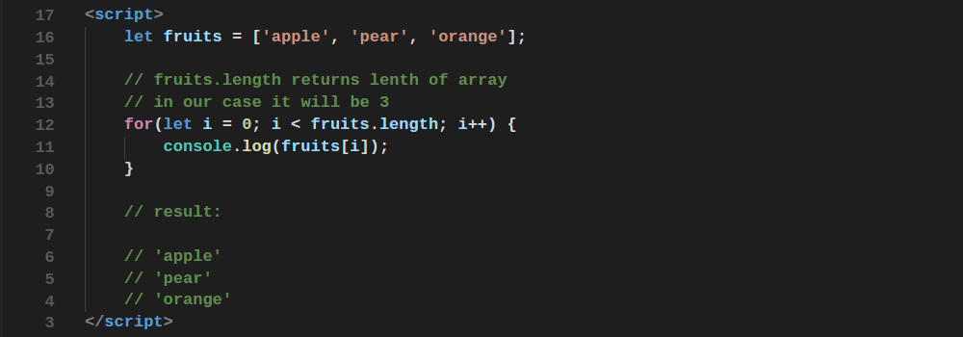
Array Length
Iterating through array using loop

Slide 27
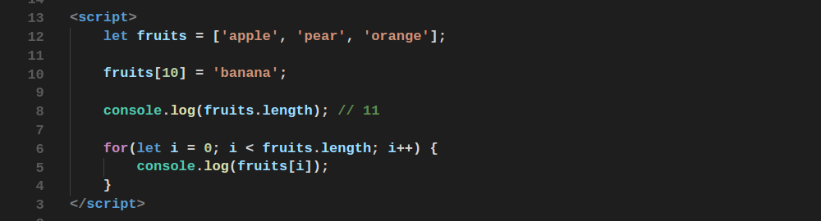
Array Length
Sparse array
I

Slide 28
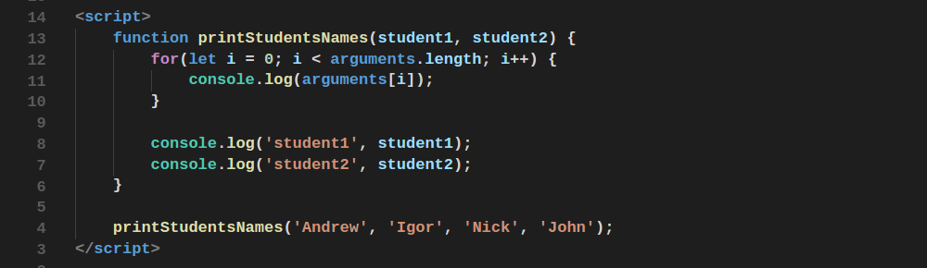
Arguments
The arguments object is an Array-like object corresponding to the arguments passed to a function
I

Slide 29
Recursion
Recursion is a programming pattern that is
useful in situations when a task can be naturally
split into several tasks of the same kind.

Slide 30
Recursion
In order to understand recursion, you must first understand recursion.

Slide 31
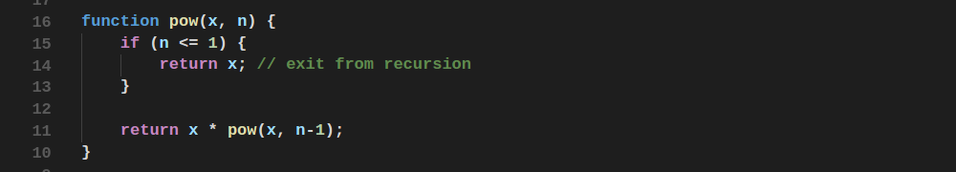
Recursion
Recursive way to find a pow
I

Slide 32
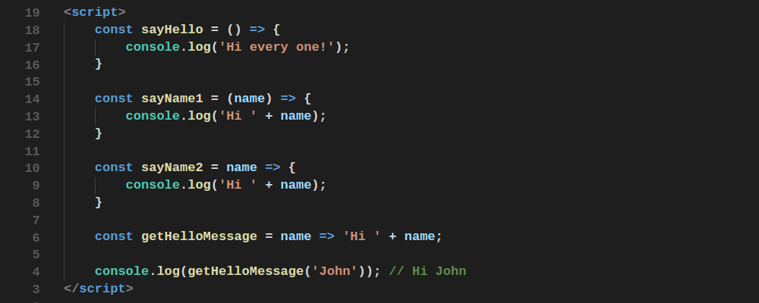
Arrow Functions

Slide 33
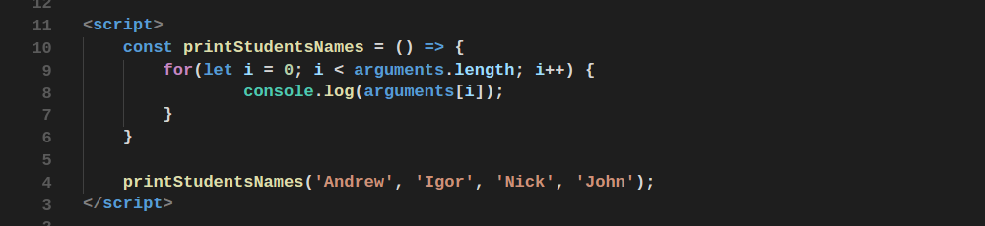
Arrow Functions
This is new in ES6. Arrow functions have couple differences with ES5 functions.
Arrow Functions don’t have arguments object.
Arrow Functions don’t have own context. They use context of a parent. (see in next episodes)
I

Slide 34
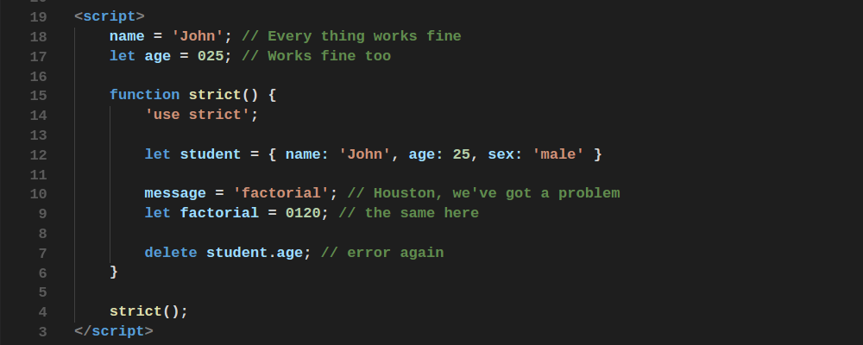
Functions Strict Mode

Slide 35
Home Work
Write a function that retrive 2 arrays and return an array with numbers from the first array which aren't present in the second array;
Write two functions that return number from fibonacci sequence by a given index, use recursion and iterative approach;
Write two functions that return factorial of a given number, user recursion and iterative approach;

Slide 36
Thanks for attention

